Slide 1

POWER BI · POWER QUERY EDITOR
How Do You Fix
Data This Messy?
Two null rows, six merged fields, and no usable headers. Meet Power Query - nine deliberate steps that turn this panic into a clean, sortable table.
9
10
0
TRANSFORM STEPS
FINAL COLUMNS
NULL ROWS REMAINING
Mood: messy data.
1

Slide 2









The Transformation Workflow
Nine sequential Power Query steps turn a messy spreadsheet import into a validated, sortable, reporting-ready table.
01
02
03
Remove Blank Rows
Promote Headers
Rename Columns
Delete the 2 leading null-only rows
Row 3 becomes the column header
Apply clear, meaningful names
04
05
06
Split Customer Name
Split Contact Info
Extract Year
First Name / Last Name
Email Address / Phone Number
New Year column from Date
07
08
09
Sort by Products
Reorder Columns
Verify & Finalize
Ascending alphabetical order
Arrange to final layout
Confirm zero nulls, correct types

Slide 3
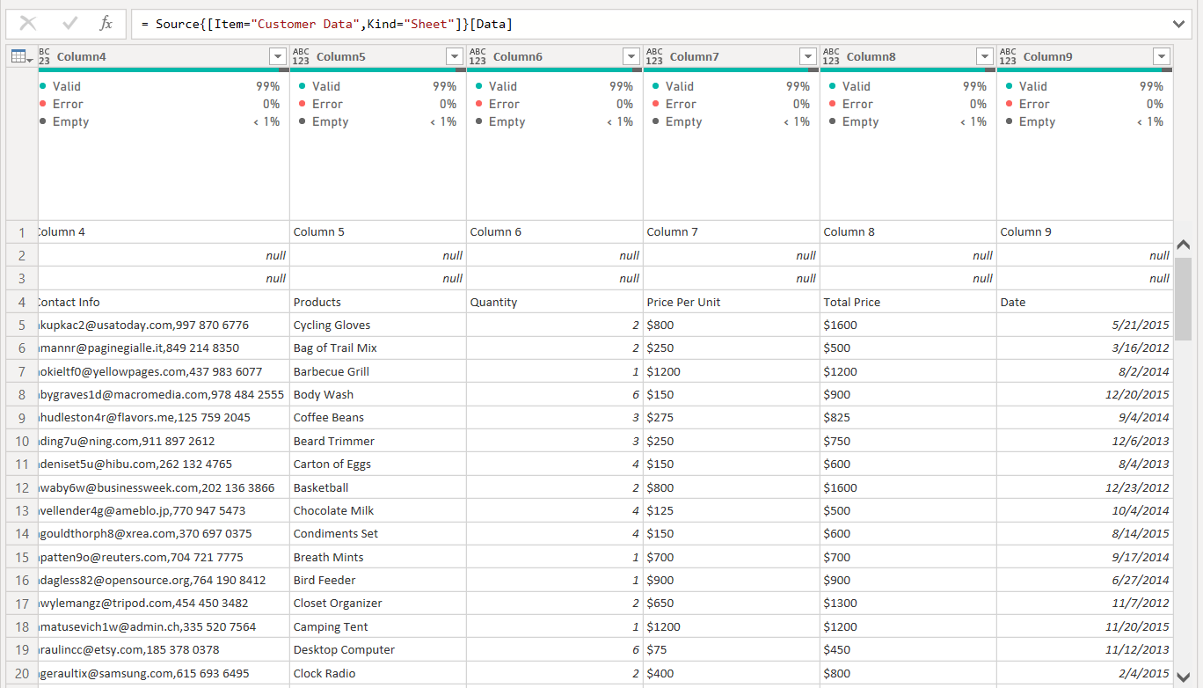

STEP 00 · STARTING POINT
An Unusable Raw Export
Generic Headers
Columns load as Column4 - Column9; the real field names sit buried in row 4.
Two Blank Rows
Rows 2 and 3 are entirely null and carry no analytical value.
Combined Fields
Contact Info and Customer Name each pack two data points into one cell.
Net Result
A clean starting point for the 9 transform steps that follow.

Slide 4
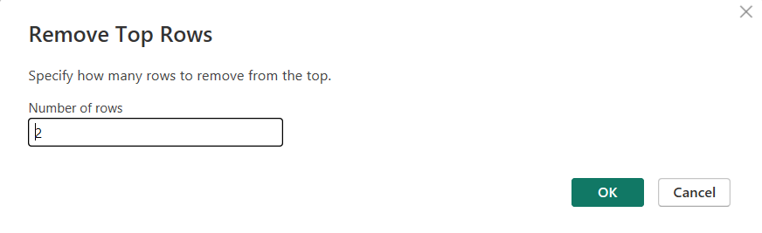
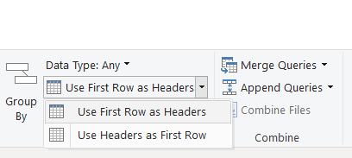
STEP 01–02 · STRUCTURE
Remove Rows & Promote Headers
Home → Remove Rows → Remove Top Rows (2), then Use First Row as Headers to promote the real field names.
Remove Top Rows
Use First Row as Headers
Transform tab → Use First Row as Headers
2 rows removed- both were entirely null.
Row 3 (Contact Info, Products, Quantity…) is promoted to become the header row.

Slide 5
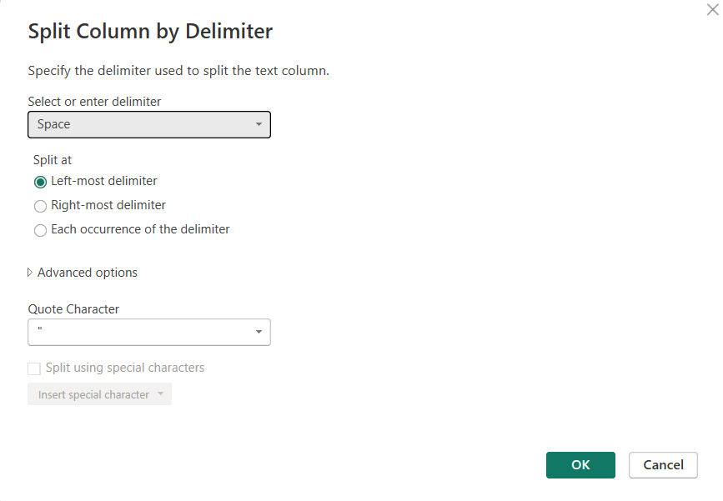
STEP 04 · COLUMN SPLIT
Splitting Customer Name
Transform → Split Column → By Delimiter
Delimiter: Space, split at the left-most occurrence.
First Name
Text before the space delimiter
Last Name
Text after the space delimiter

Slide 6
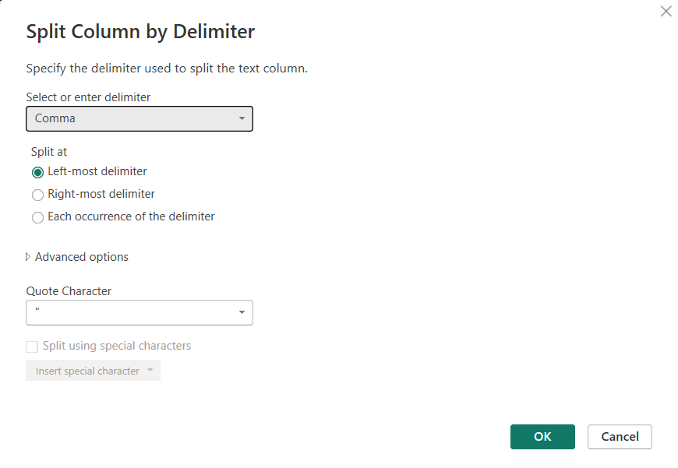
STEP 05 · COLUMN SPLIT
Splitting Contact Info
Transform → Split Column → By Delimiter
Delimiter: Comma, split at the left-most occurrence.
Email Address
Text before the comma delimiter
Phone Number
Text after the comma delimiter

Slide 7
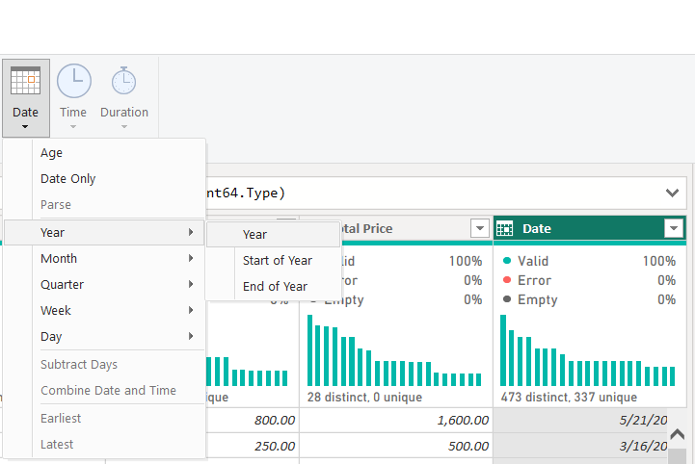

STEP 06 · DATE INTELLIGENCE
Extracting the Year
Select the Date column
Add Column → Date → Year → Year
Power Query reads each Date value and generates a new Year column, giving the table a ready-made field for time-based grouping and reporting.
New Column: Year
5 distinct values · derived directly from Date, 0 errors.

Slide 8

STEP 07–09 · FINAL STRUCTURE
Sort, Reorder & Trim the Table
With every field split and typed correctly, the table is put into its final reporting shape.
Sort Ascending
Reorder Columns
Remove Extras
Table sorted by the Products column, A → Z, so related items group together.
Order ID, First/Last Name, Address, Email, Phone, Products, Quantity, Price, Total, Date, Year.
Any leftover blank rows or helper columns are cleared from the query.

Slide 9
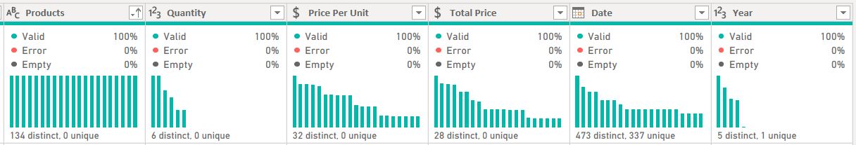
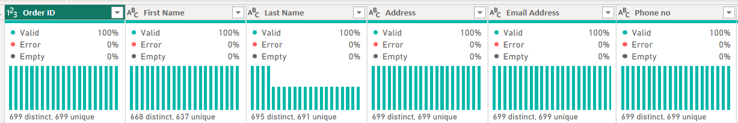
STEP 10 · QUALITY CHECK
The Final, Verified Dataset
Column-quality view confirms 100% valid values across every field - no errors, no empties, table is ready for the analysis.

